Slide 1
ECE 434 Final Project
IMU
Daniel Ao, Kevin Hu
Dao3, kwh2

Slide 2
Implementation and Design considerations
Constant step length vs dynamic step length
PCA vs per step analysis for walking direction

Slide 3

The problem - localization
For our project, the goal was to create a fully functional dead-reckoning based indoor localization system
The tools given to solve this problem come from the IMU sensor that provides us with accelerometer and gyroscope data
From the given data, we were able to find the number of steps n, the walking direction 𝛳, and the step length L, in order to calculate the position at every data sample
This simple compact form shows the formula for position
Notes:
MP1 and MP2 focus on parsing these types of data - they were important building blocks that could be reused in this project. The purpose of this project was to be able to localize using dead reckoning and ideas that we’ve learned during the semester

Slide 4
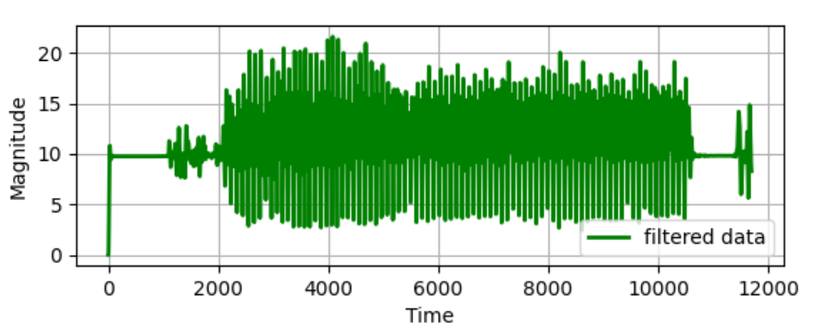
The First Problem - step counting
Step counting is essential to localization from IMU data and we were able to reuse our MP1 strategy to get the number of steps solely from the accelerometer data
While using route 1 accelerometer data, the steps are easily discernible
Notes:
Our implementation uses a butterworth filter which is easy to implement and extract data from as we only had to specify a cutoff frequency and order. This code is reused from MP1 and is pretty simple

Slide 5
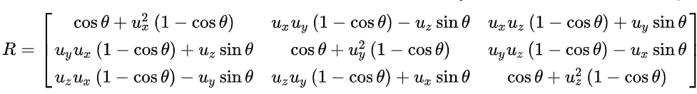
The Second Problem - walking direction
Walking direction is essential to localization because our user has two dimensions of travel. Without the direction of travel, there is no way to accurately determine position in 2D space
We were able to reuse code from MP2 but had to further our implementation because walking direction requires global reference frame orientation
By making use of linear algebra properties and per step analysis with the gyroscope data we could find the walking direction, 𝛳
Shown is the formula and code that makes up for the bulk of this implementation - solving for the rotation matrix
Notes:
We essentially get a new orientation matrix at every time step and must get the dot product of the new rotation matrix with the old.

Slide 6
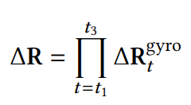
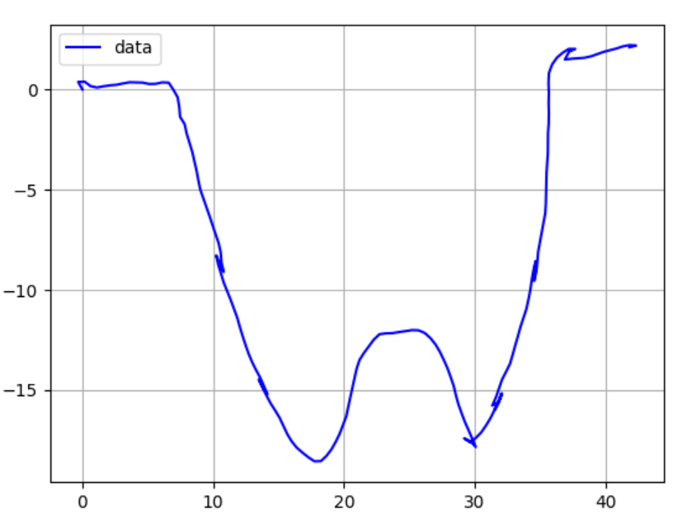
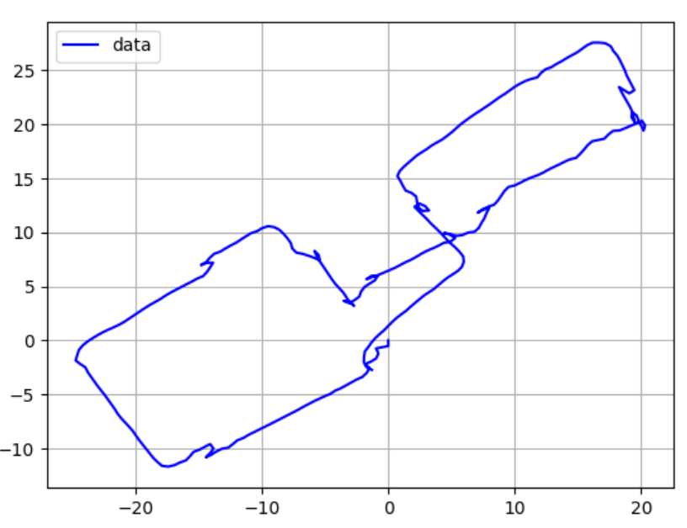

Tying it together
Now that we have the rotation matrices and the number of steps, we must combine our data to form a path that shows the position at every time step
This requires two integrals
Integrate from current peak until the midpoint (first step) and calculate axis of rotation, repeat from midpoint to next peak
Shown are the output paths of route 1 and 2

